Slide 1
Niner Mine
Jesus Geronimo-Guevara, Shiven Bhardwaj, Birava Savalia, Celine Qin, Jnana Krishnamsetty
5/02/2025

Slide 2
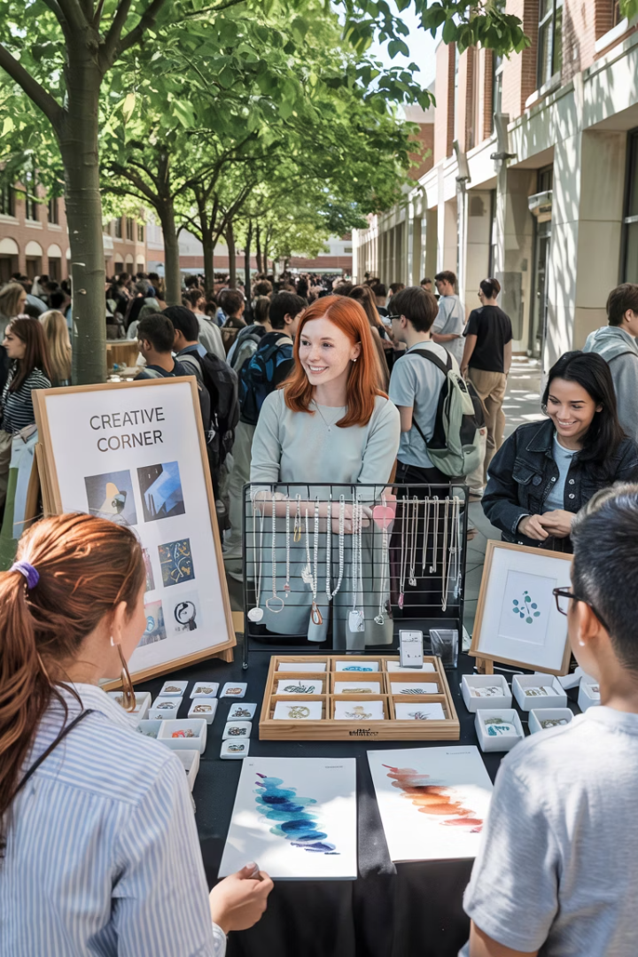
Niner Mine: Student-Powered Marketplace
Welcome to our final presentation on Niner Mine, a student-powered marketplace built at UNC Charlotte where creativity meets community.
Our platform enables students to showcase and sell their creations while connecting buyers with unique campus-made products.
*AI Generate Image

Slide 3
Introduction
Title
Agenda
Problems & Objectives
Methodologies
Tech Stack
Architecture
Demonstrations
Site Screenshots
Live Demo
Code Organization
Key Features
Analysis
Conclusions & Takeaways
Next Steps
Conclusion
Q&A
Agenda

Slide 4






Problem & Objectives
Vision
Creating economic opportunities for student creators
Community
Connecting campus creators with buyers
Platform
Full-featured marketplace for student products
Niner Mine addresses the need for student creators to monetize their talent. Accessing affordable and relevant products without relying on external marketplaces

Slide 5








Technology Stack
Frontend
Backend
Vite + React
Python (Flask)
Hosting
Database
AWS EC2 with FileZilla for deployment
PostgreSQL via Supabase
Our solution leverages modern technologies. This stack ensures scalability and maintainability for long-term growth.

Slide 6
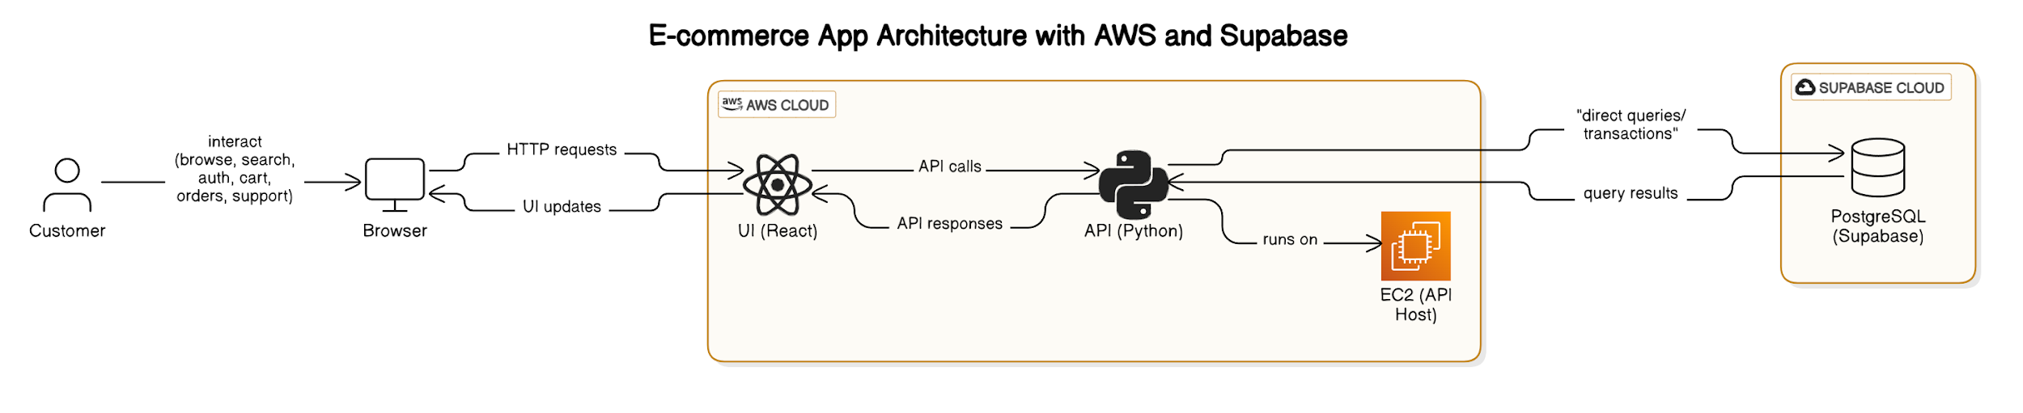





System Architecture
Client
Frontend
Backend API
Data Layer
Browser access by students and buyers
React UI hosted on AWS EC2
Flask middleware handling business logic
PostgreSQL with Stripe payment integration
Our architecture follows industry best practices. The separation of concerns enhances maintainability and scalability.

Slide 7
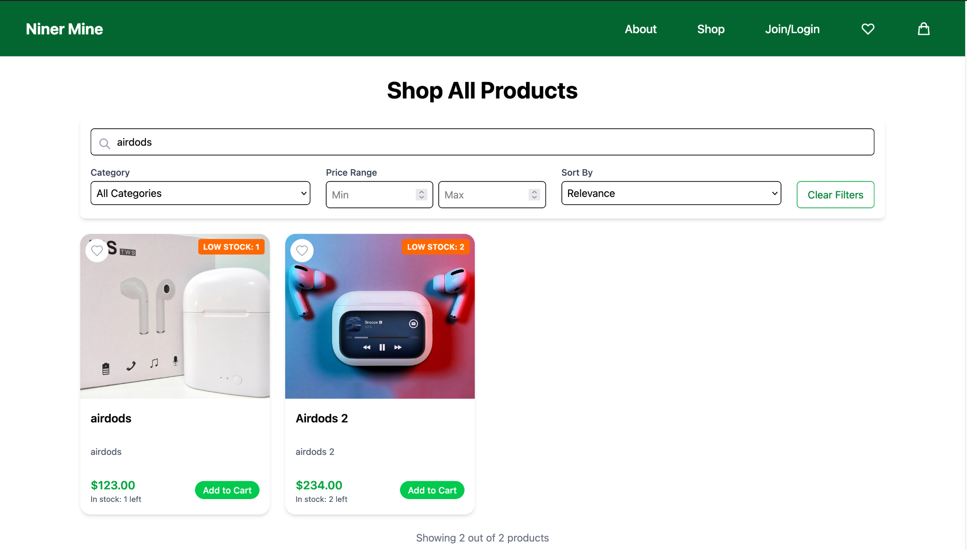
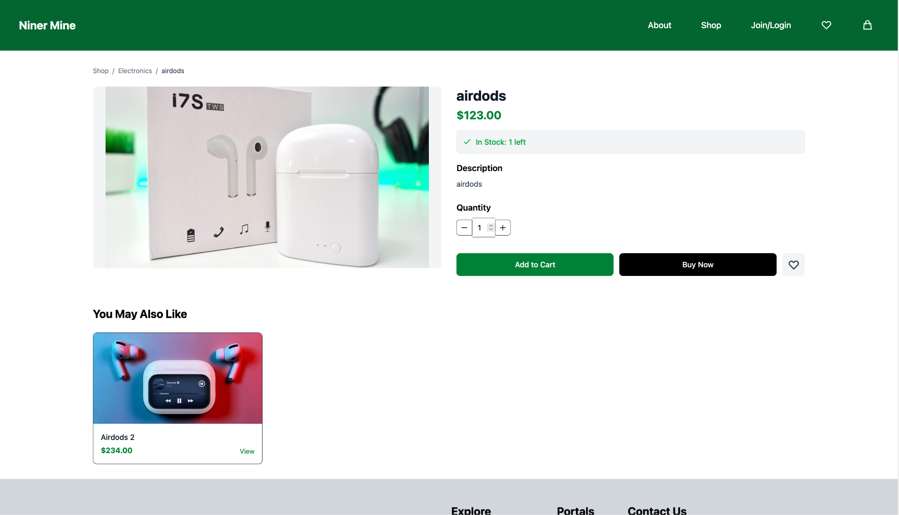
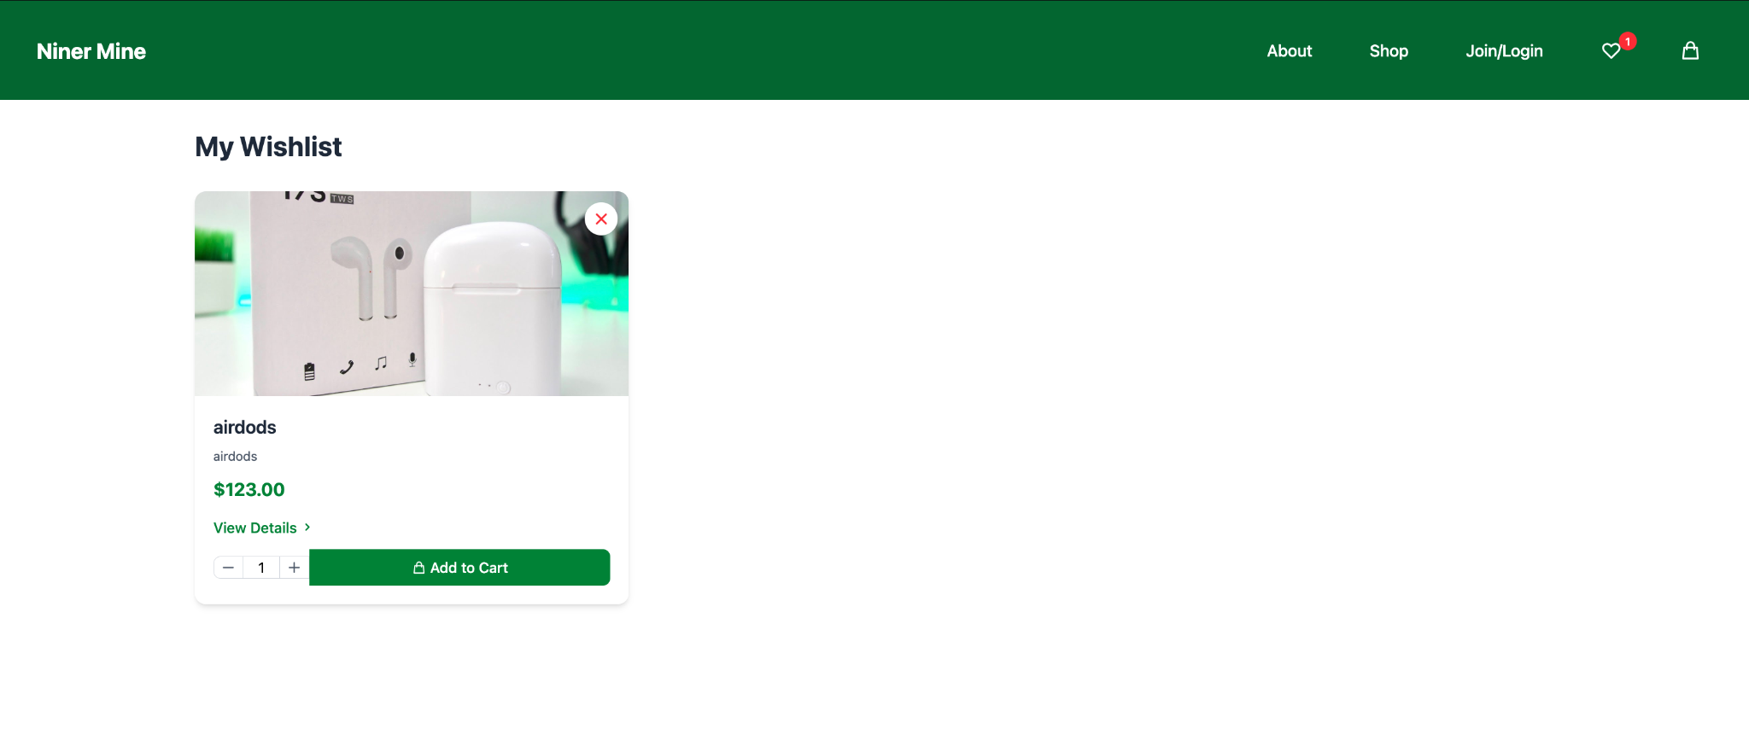
Results / Demonstration
Customer
Search
Shop
Wishlist

Slide 8
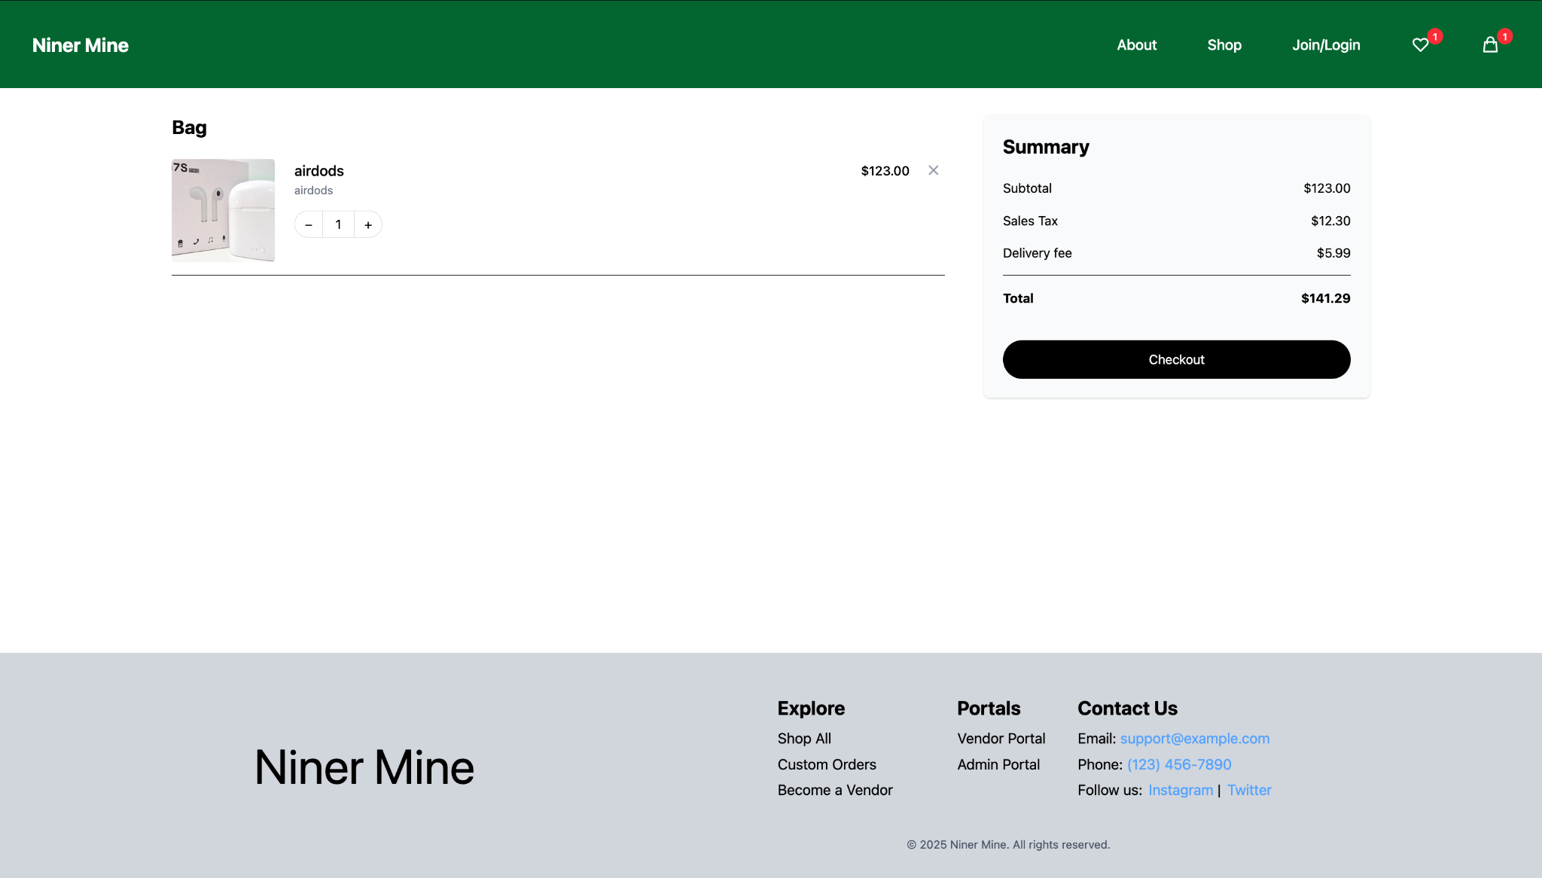
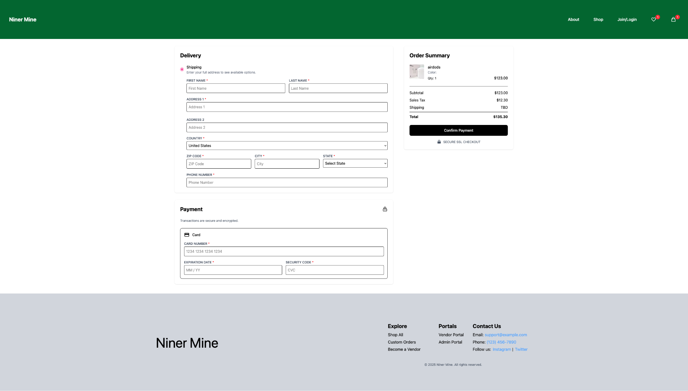
Results / Demonstration
Customer
Cart
Checkout

Slide 9
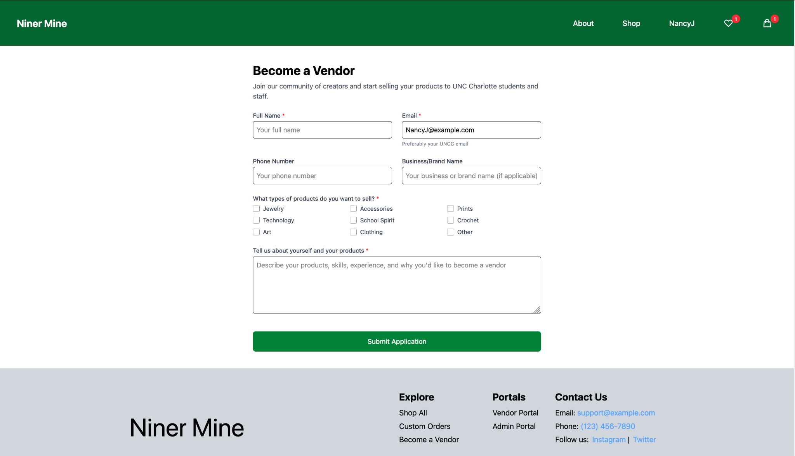
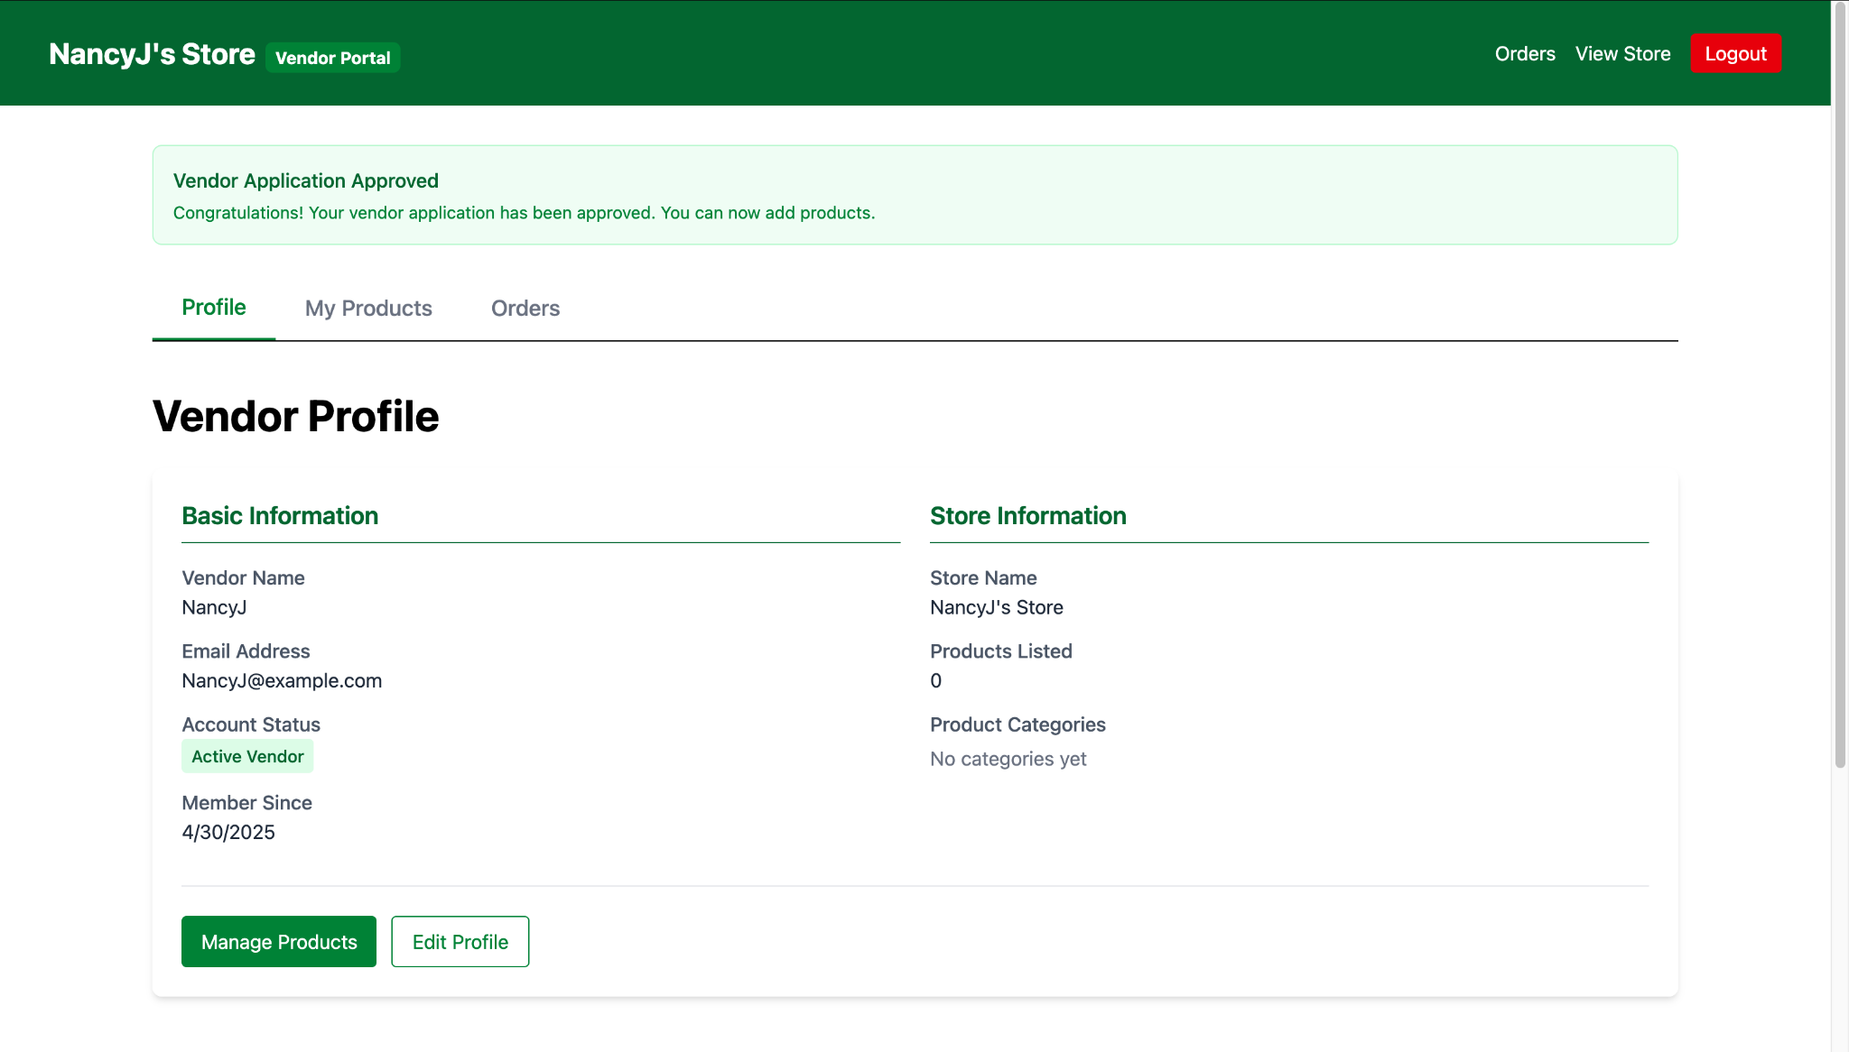
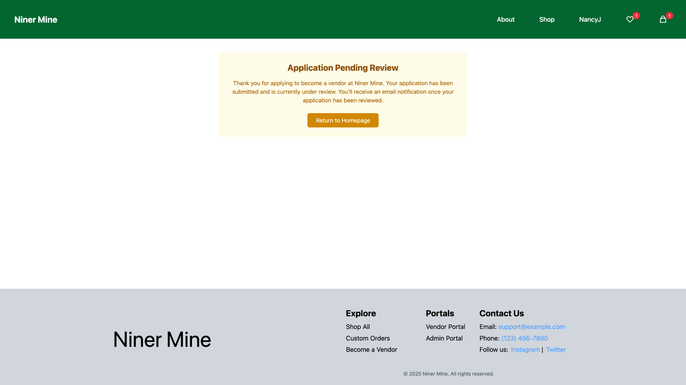
Results / Demonstration
Vendor
Become a Vendor Application
Vendor Portal
Vendor Application Submitted

Slide 10
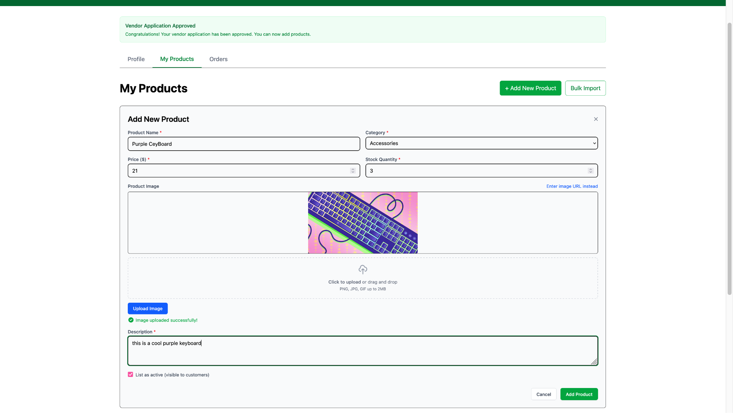
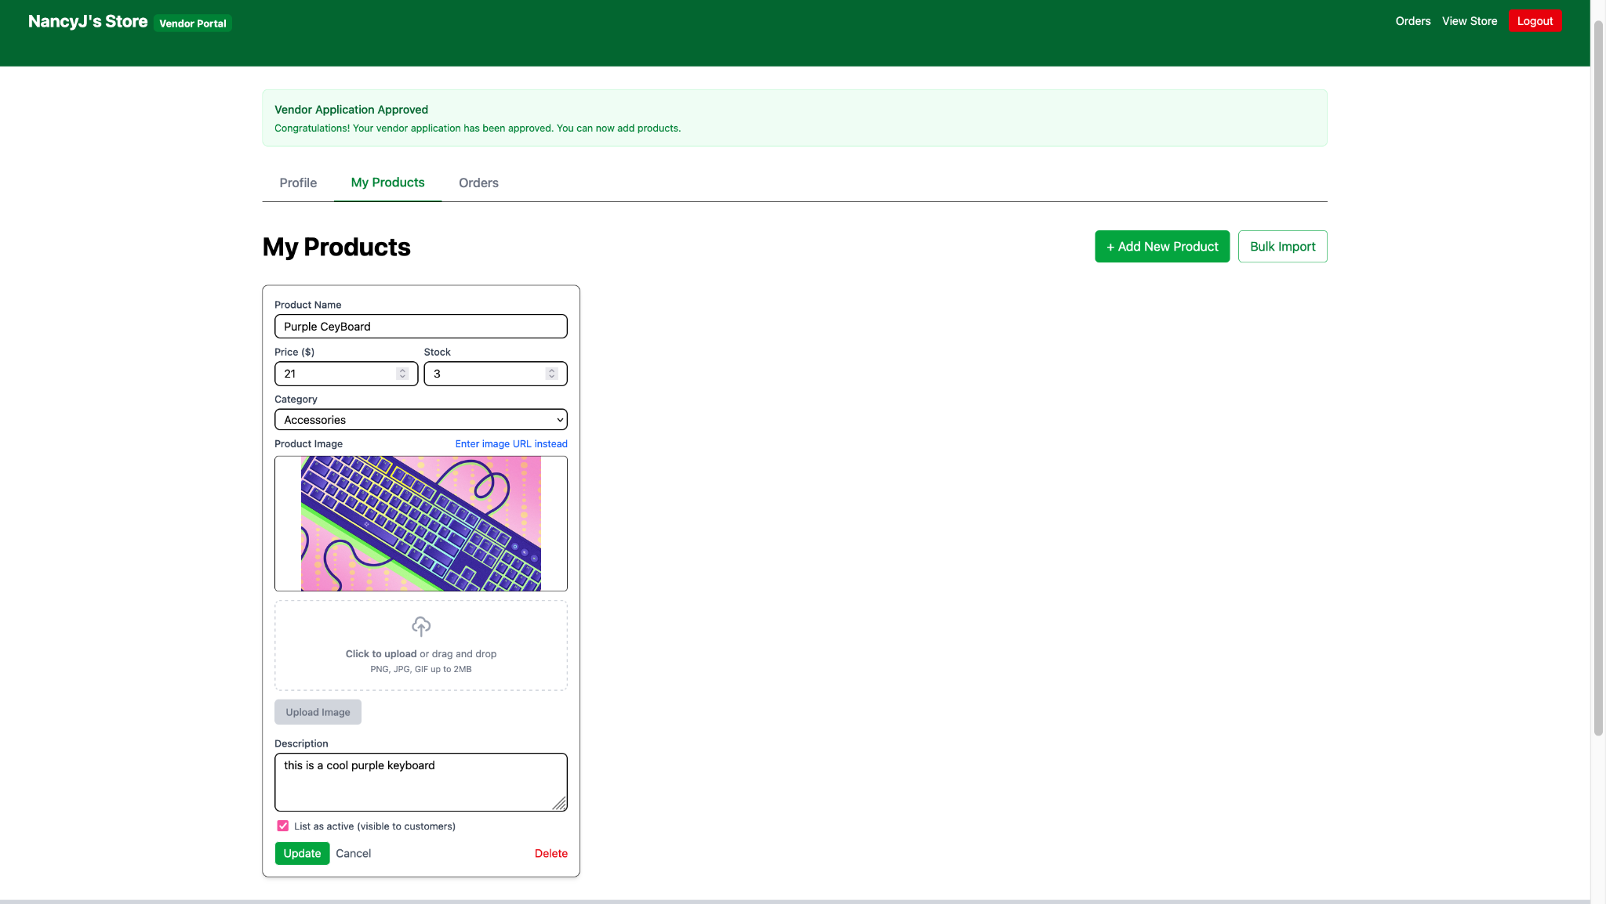
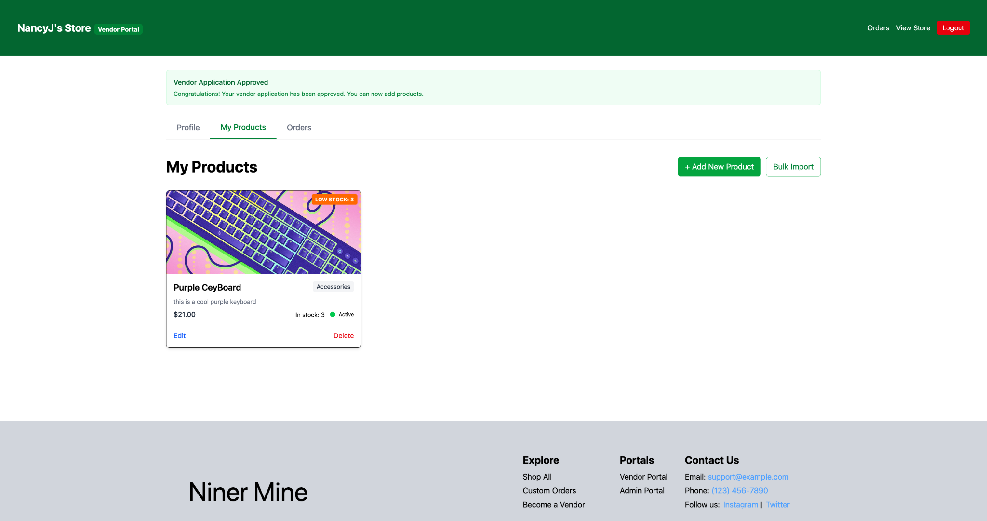
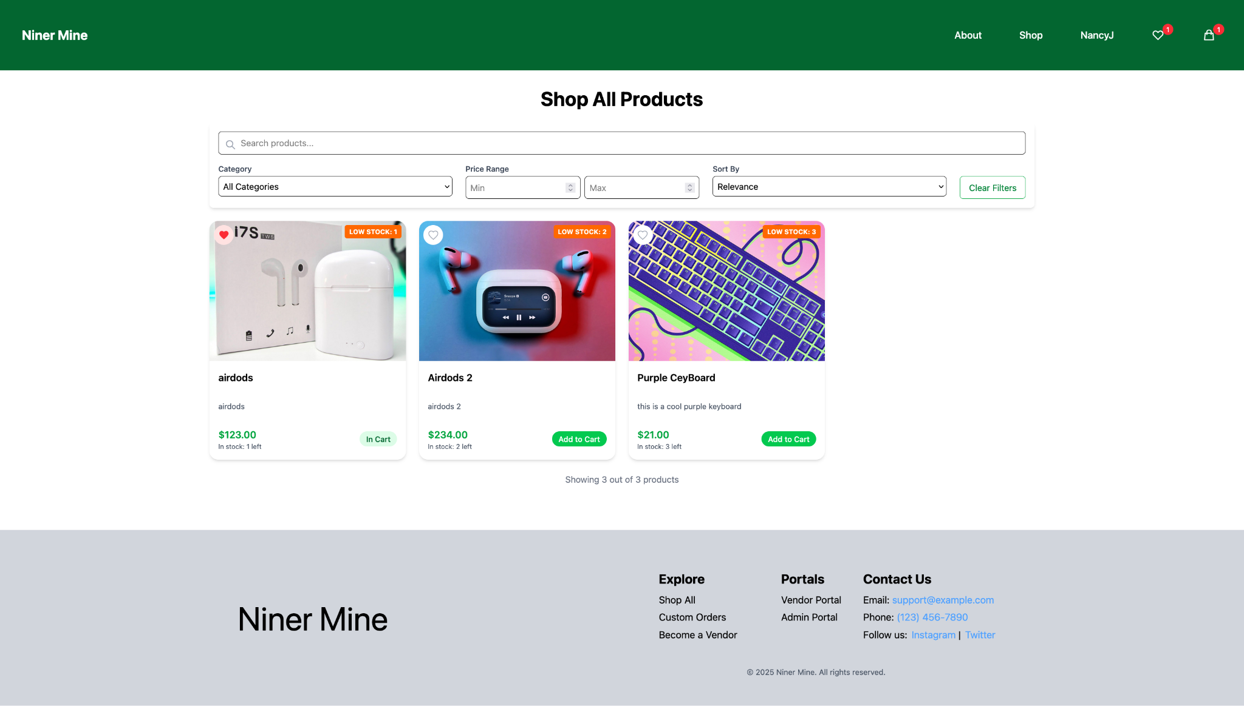
Results / Demonstration
Vendor
<- Add Products
Update/Delete Products ->
<- Vendor’s Products
Vendor’s Products in Shop ->

Slide 11
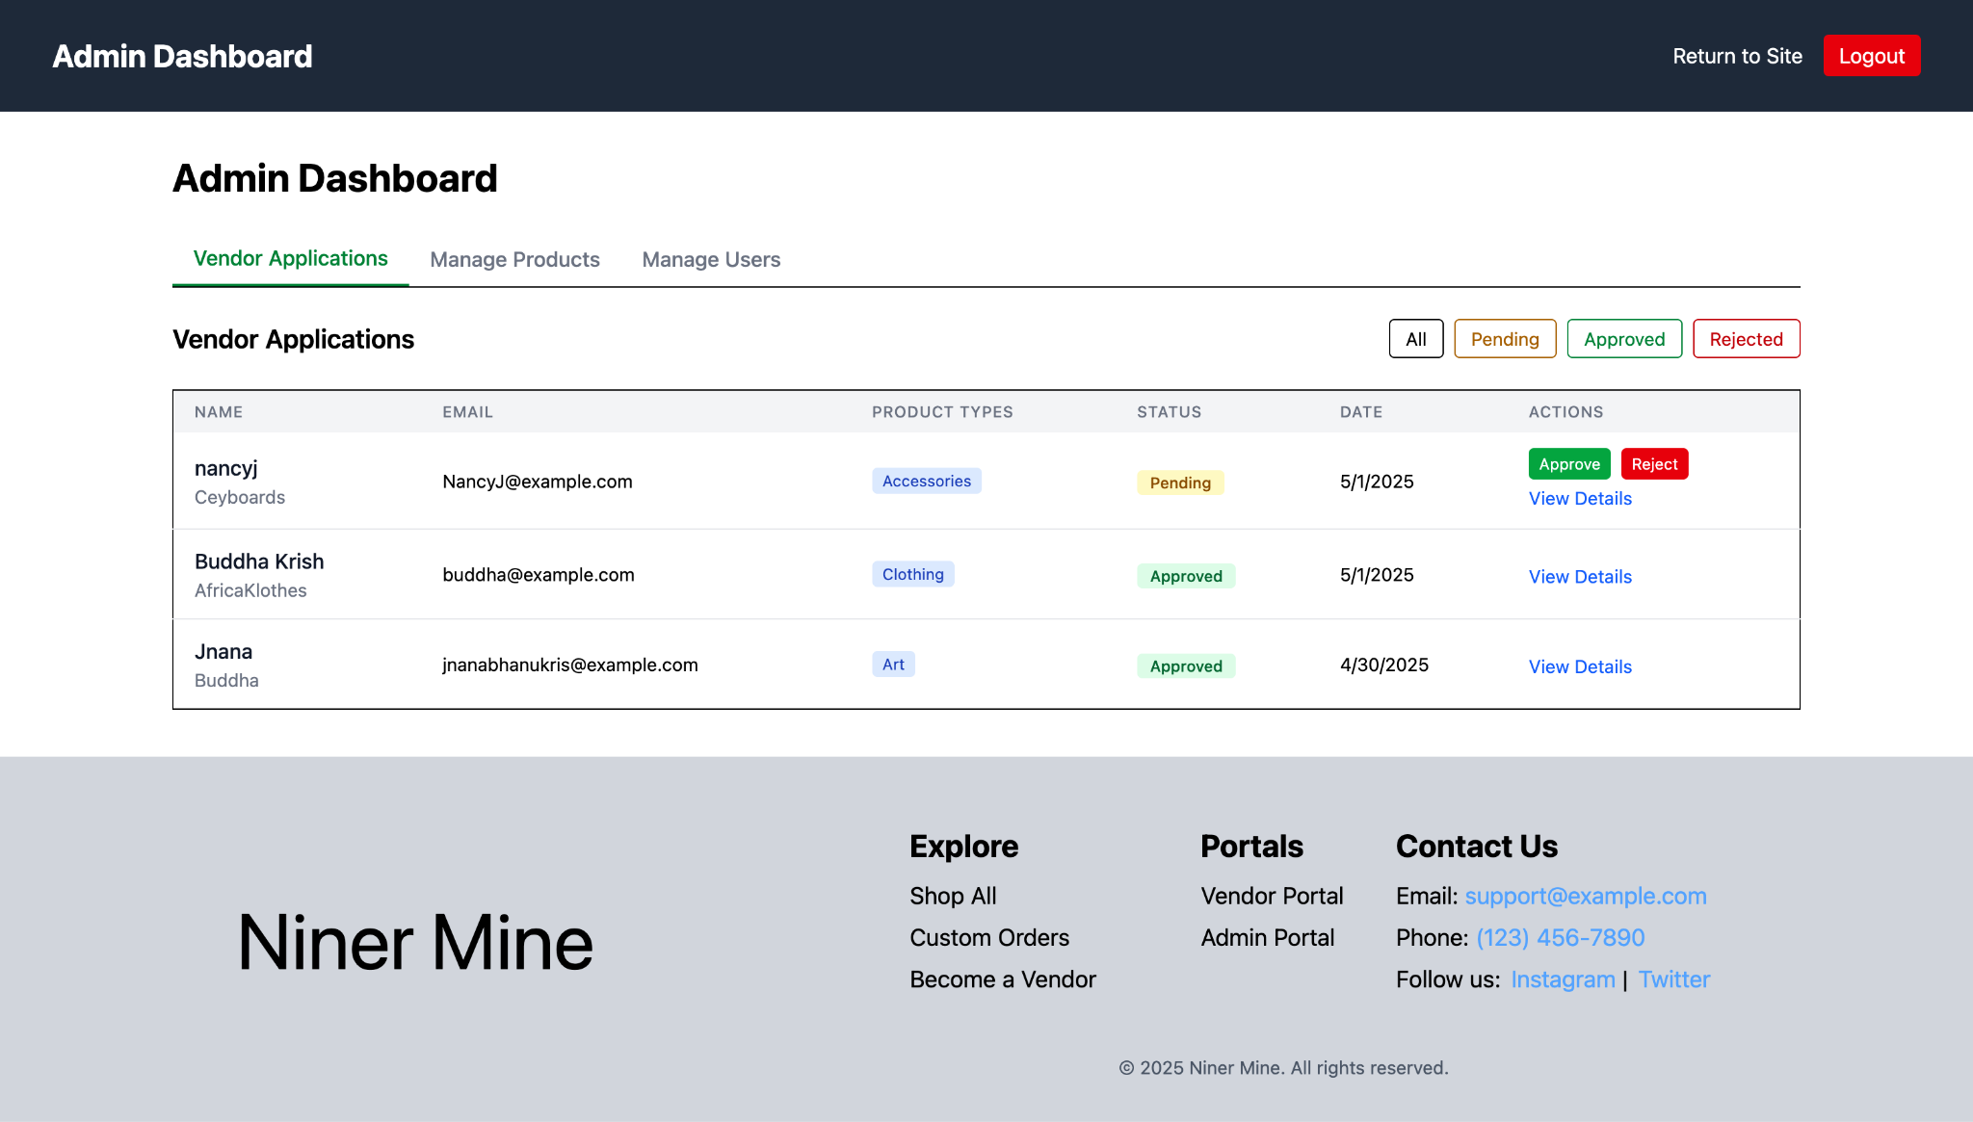
Results / Demonstration
Admin
Approve/Reject Vendor Applications
Approved Vendor
Vendor Portal
Admin Portal

Slide 12
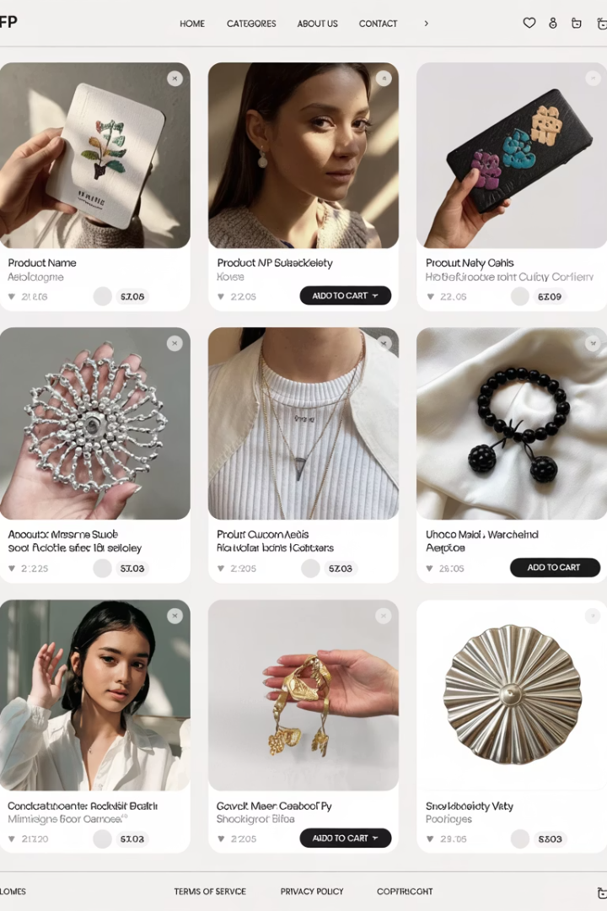
*AI Generate Image
Key Features
Vendor Onboarding
Student creators can register and list products with detailed specifications and images.
Product Discovery
Intuitive browsing experience with categories, search, and filtering options.
Shopping Experience
Add to cart, checkout flow, and secure payment processing via Stripe.
Order Management
Tracking, notifications, and status updates for both buyers and sellers.
These features were all completed in Sprint 3. They form the core functionality of our marketplace.

Slide 13
Analysis
What worked?
Structured product categories made selection simple.
Personal description field allowed creative expression.
Key features like "Become a Vendor," "Add to Wishlist," and "Add New Product" are fully functional.
What didn’t work?
Some fields (e.g., Phone Number) could have clearer formatting instructions.
Pressing log out in the Admin Portal does not work
Wishlist and Cart details are cached to session storage rather than under the User
Vendor public profiles (from home page) show all products rather than their specific products
For the forget Password utility SMTP was the only framework implemented

Slide 14

*AI Generate Image
Next Steps
Campus Integration
Mobile Optimization
Partner with university departments for official endorsement and promotion.
Feature Expansion
Develop responsive design for mobile users and potential native app.
Add ratings, reviews, and recommendation engine to enhance user experience.
Niner Mine successfully delivers a complete marketplace for student creators. Our platform empowers students to showcase talents and build entrepreneurial skills.

Slide 15
Conclusion
What worked well
What we had to adapt
Key Takeaways
The vendor signup process was easy to use.
Key features worked smoothly:
Shopping: Adding to Wishlist, Adding to Cart.
Vendors: Adding/Updating/Deleting products as a vendor and it reflecting to the public shop.
Become a Vendor application, and Admin Portal to approve vendor applications.
The setup between frontend and backend worked smoothly without any difficulties.
Streamlined UI components to better facilitate the backend.
Refactored parts of backend logic to better support vendor approval and product management.
Adjusted hosting and deployment process using AWS EC2 and FileZilla to handle early technical issues.
Clean architecture and early planning save time later in development.
Student communities are eager for platforms like this that combine creativity, commerce, and connection.
Communication is key to ensure that everyone is up to date with the current codebase.

Slide 16

Q&A Time
Thank you for your time!

